Slide 1
Robust Driver Assistance System based on Computer Vision
Anishsanjay Nayak
G40823950

Slide 2
Driver Assistance Systems
Developed to automate/adapt/enhance vehicle systems for safety and better driving
Features designed to avoid collisions and accidents by offering alerts to potential problems or taking over control of the vehicle
Relies on inputs from various sources like:
Automotive sensors
LiDAR
Radar
Image processing
Computer Vision

Slide 3
Driver Assistance Systems (features)
Adaptive/Autonomous cruise control
Automotive navigation system
Collision avoidance system
Driver monitoring system
Lane departure warning
Traffic sign recognition
Notes:
Cruise control – automatically adjusts vehicle speed to maintain a safe distance from other vehicles
Navigation – find the fastest route to the destination based on GPS and traffic data
Collision avoidance – reduce severity of collision by using radar, lidar and image recognition to detect an imminent crash
Driver monitoring – infrared sensors to monitor driver attentiveness
Lane departure – warning when the vehicle begins to move out of its lane

Slide 4
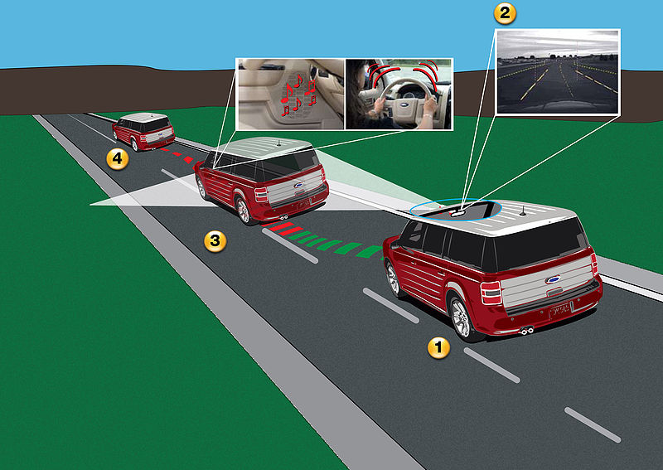
Lane departure warning systems
Warns the driver in some form (visual, audible, vibratory) if the vehicle is leaving its lane
If no action is taken, takes steps to stay within the lane
Working principle – lane detection and tracking systems to identify the current lane of travel

Slide 5
References
https://en.wikipedia.org/wiki/Advanced_driver-assistance_systems
https://commons.wikimedia.org/wiki/File:Lane_Departure_Warning.jpg
https://en.wikipedia.org/wiki/Lane_departure_warning_system

